Slide 1
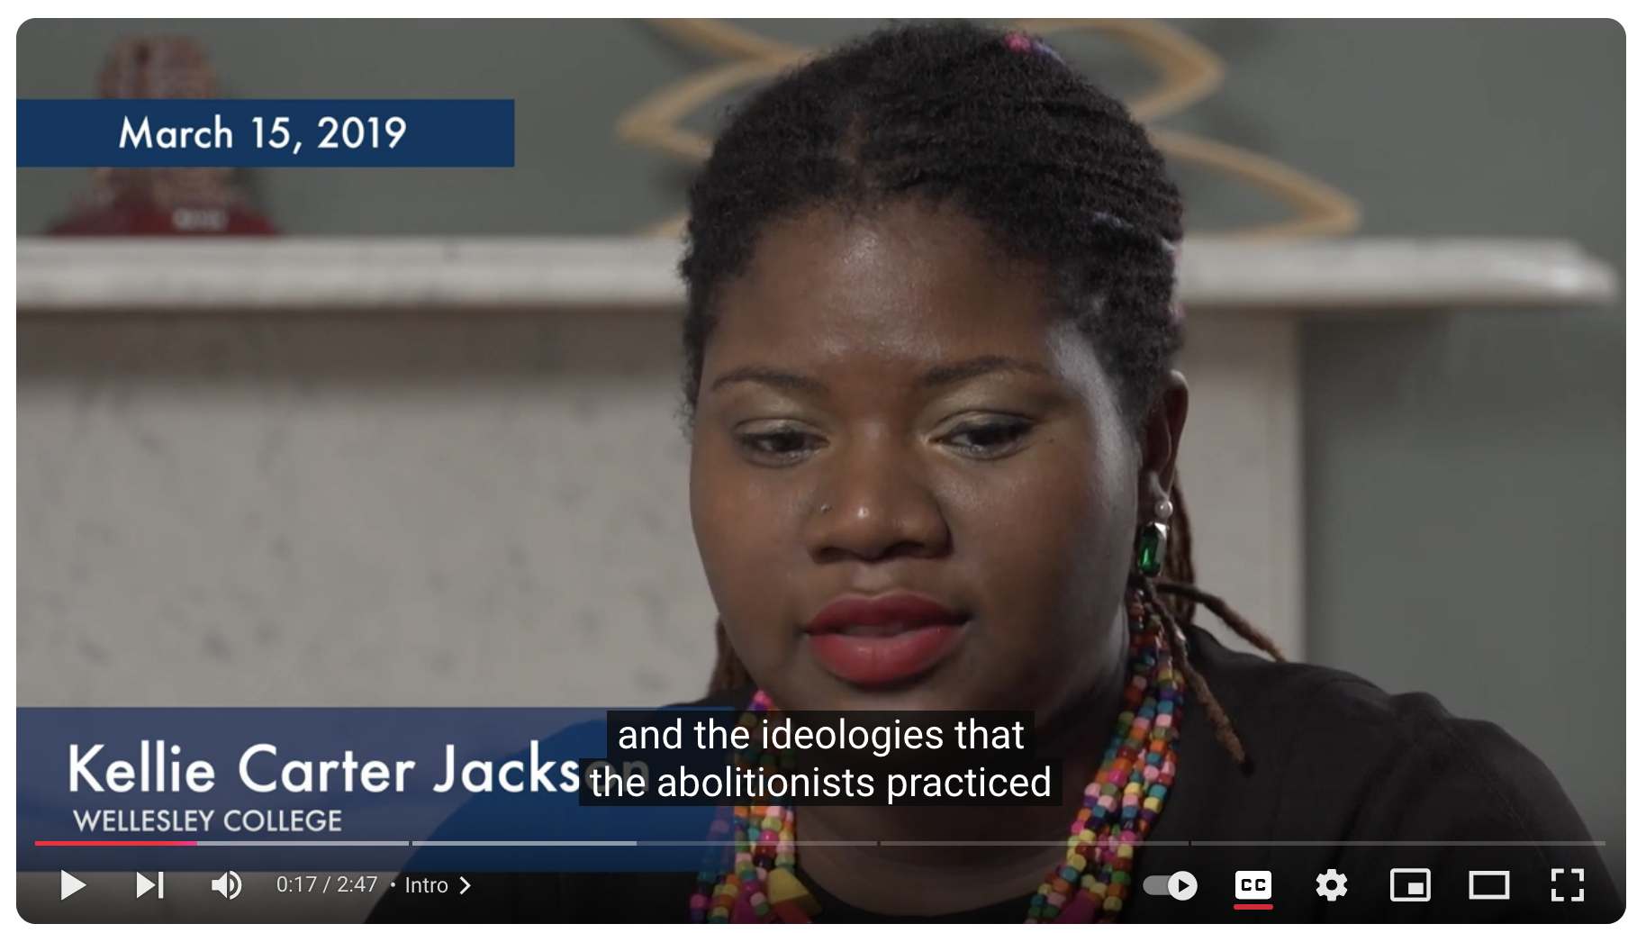
Popular movements and climate change
The abolition movement as a model for social change
Can we use the successes and failures of past popular movements to construct a popular movement combatting climate change?
Professor Richard Anderson-Connolly will be sharing some of his work on this question.

